Slide 2
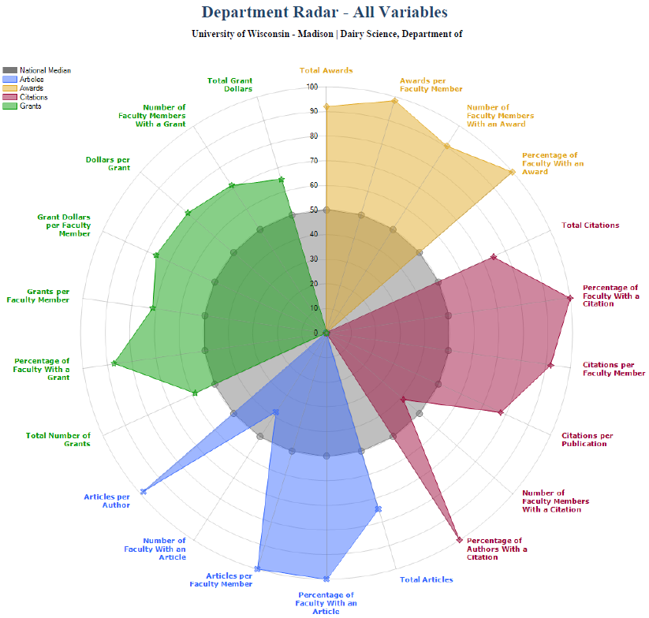
Academic Analytics Profile
Ranking among 62 animal science programs nationwide
48th in number of faculty
17th in total journal articles
1st in articles per faculty
17th in total citations
6th in citations per faculty
6th in total awards
2nd in awards per faculty
23rd in total grant dollars
16th in grant dollars per faculty
2nd in overall faculty scholarly productivity index

Slide 3
Departmental Trends in the Past Decade
 | 2004 | 2005 | 2006 | 2007 | 2008 | 2009 | 2010 | 2011 | 2012 | 2013
Faculty Members (n) | 14.4 | 14.4 | 12.4 | 12.4 | 12.4 | 13.4 | 13.4 | 11.4 | 10.4 | 11.4
% of CALS | 4.8 | 4.8 | 4.2 | 4.2 | 4.3 | 4.7 | 4.7 | 4.2 | 3.9 | 4.2
Undergraduate Students (n) | 77 | 69 | 73 | 68 | 85 | 95 | 98 | 86 | 77 | 68
% of CALS | 3.3 | 2.9 | 3.1 | 2.9 | 3.5 | 3.8 | 3.8 | 3.2 | 2.6 | 2.1
Graduate Students (n) | 35 | 31 | 28 | 26 | 28 | 32 | 31 | 39 | 40 | 33
% of CALS | 3.5 | 2.9 | 2.7 | 2.7 | 2.9 | 3.5 | 3.3 | 4.1 | 4.2 | 3.7
Federal Awards ($) | 850,770 | 194,234 | 37,314 | 752,406 | 867,884 | 1,295,415 | 2,826,147 | 895,176 | 1,011,801 | 372,538
% of CALS | 1.4 | 0.3 | 0.1 | 1.2 | 2.0 | 2.4 | 3.9 | 1.4 | 1.6 | 0.7
Non-Federal Awards ($) | 519,870 | 735,271 | 632,406 | 1,108,196 | 836,510 | 815,519 | 1,436,245 | 563,336 | 511,276 | 586,504
% of CALS | 3.5 | 6.0 | 3.8 | 7.9 | 6.1 | 4.2 | 10.4 | 3.9 | 3.6 | 3.7

Slide 4
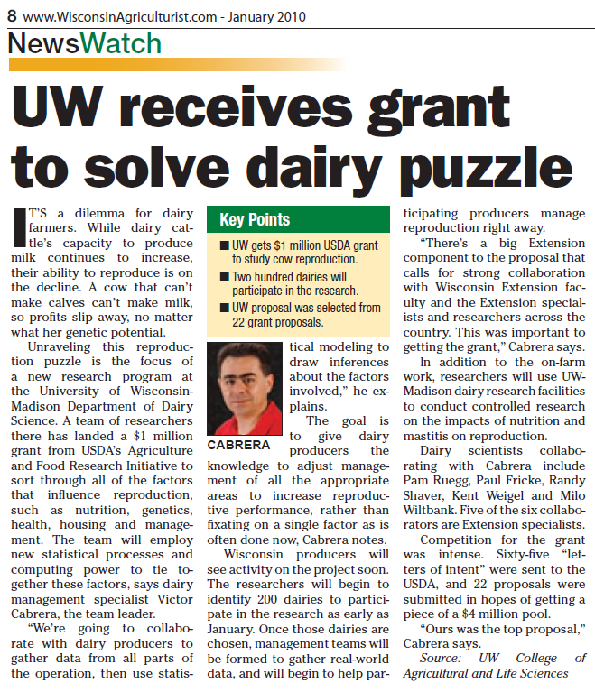
USDA-AFRI Integrated Repro Project
Cabrera et al. Integrated Reproduction Project
65 letters of intent
22 full proposals
#1 ranked proposal
$1 million for 5 years
Team of 6 scientists
All UW-Madison Dairy Science
No subcontracts!

